Slide 1
AN ANALYSIS OF CONSUMER SPENDING ON ENTERTAINMENT
Presented By
Jocelyn Allen
Kathleen Fox
Kyle Lee
Mohammad Ronosentono

Slide 2

METHODOLOGY
Used API to retrieve data and create analysis from the Bureau of Labor Statistics (BLS) 2017 Consumer Expenditure Survey
About the Consumer Expenditure Survey
Nationwide Household Survey conducted by BLS
Conducted to determine how Americans spend their money
Consists of estimates from two separate surveys: An Interview and Diary Survey
Recall survey of a period of 3 months or longer spent on various frequently purchased items.
Entertainment broken into five categories: Pets, Toys, TV and Audio, Fees and Admissions, and Other

Slide 3
RESEARCH QUESTIONS
What are the trends from 2013-2017 for the overall entertainment category in total consumer expenditure?
By age
By race
By region
Which entertainment subcategories have the highest consumer expenditure?
By age
By race
By region
What is the % of average total expenditure spent on entertainment?
By age
By race
By region

Slide 4
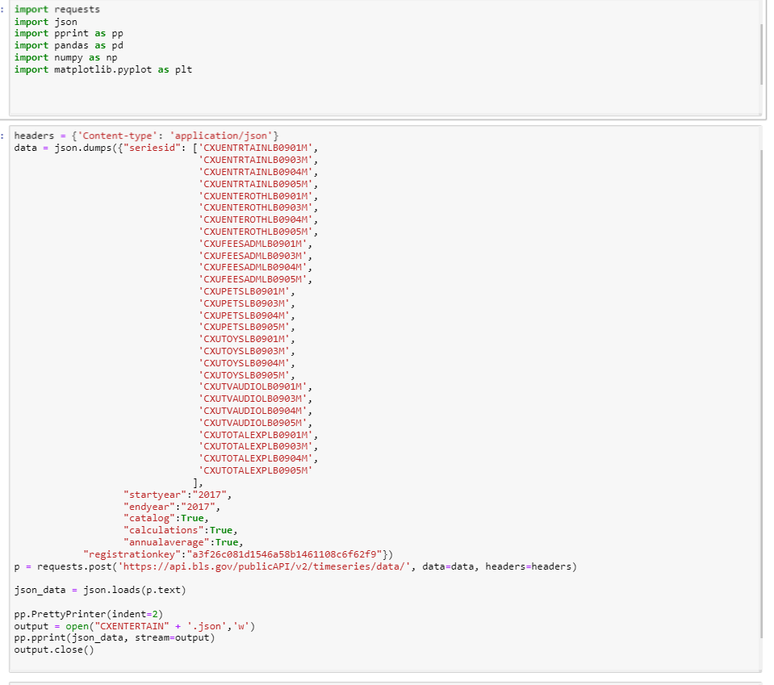
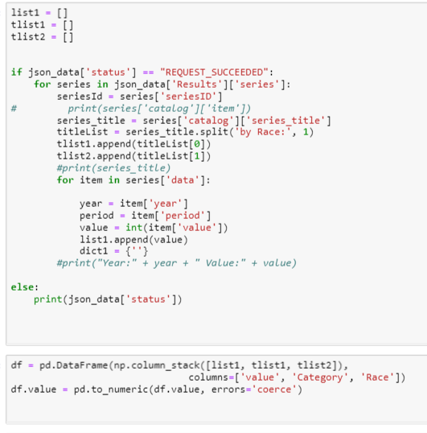
Data Exploration

Slide 5
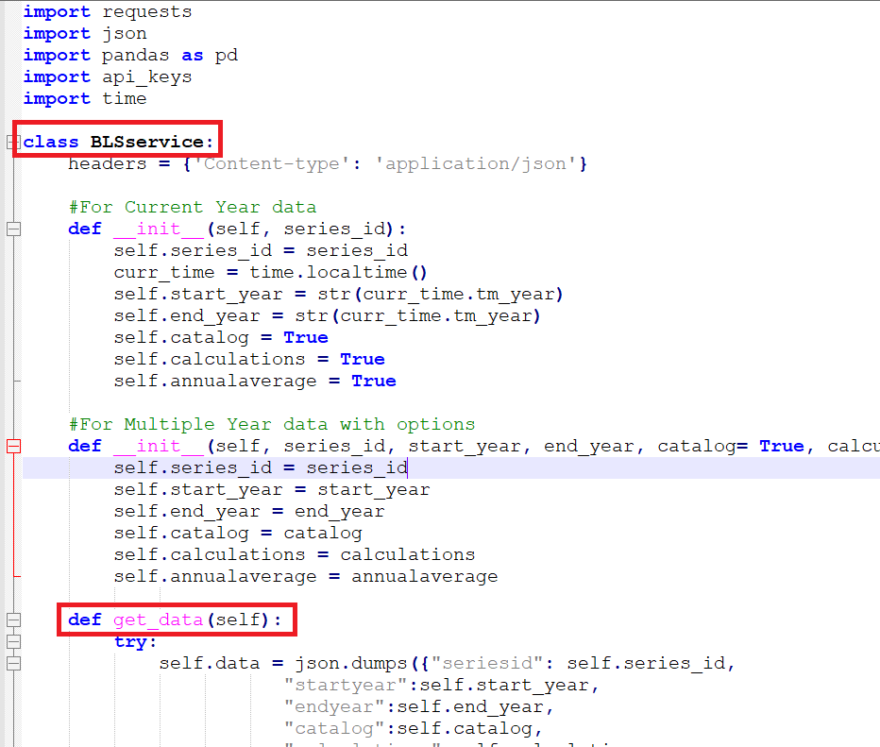
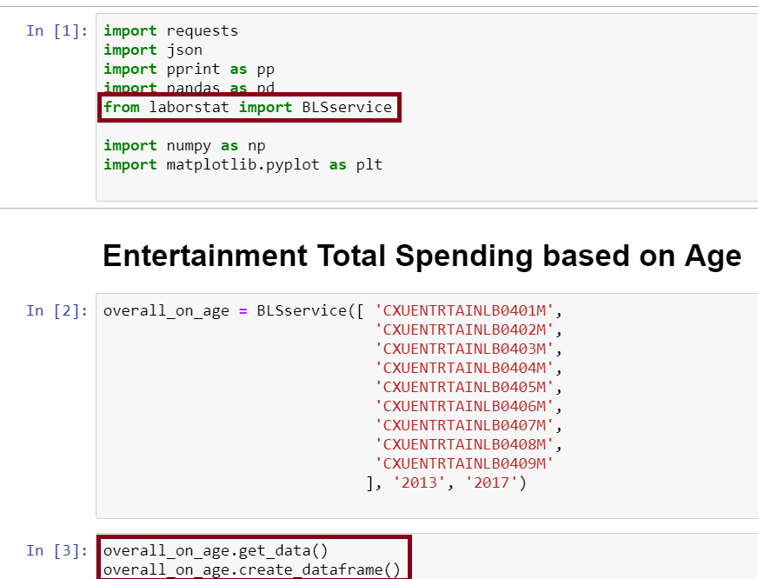
Data Exploration (Cont.)

Slide 6
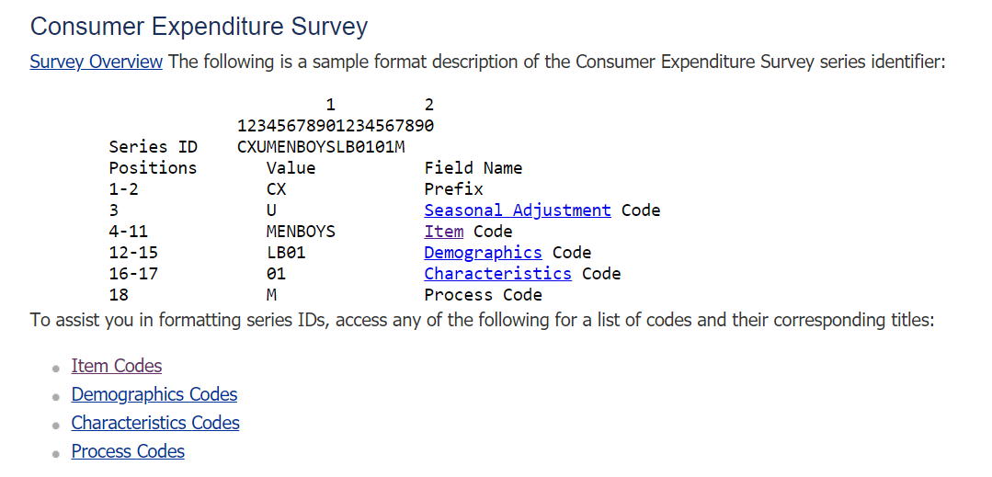
Data Exploration (Cont.)

Slide 7
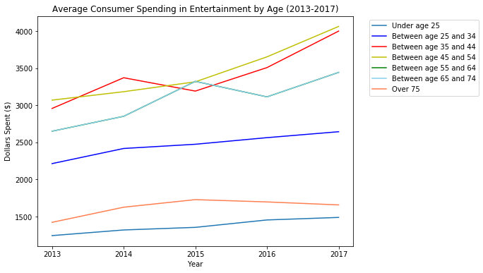
RESULTS: TRENDS BY AGE
What are the trends from 2013-2017 for the overall entertainment category in total consumer expenditure?

Slide 8
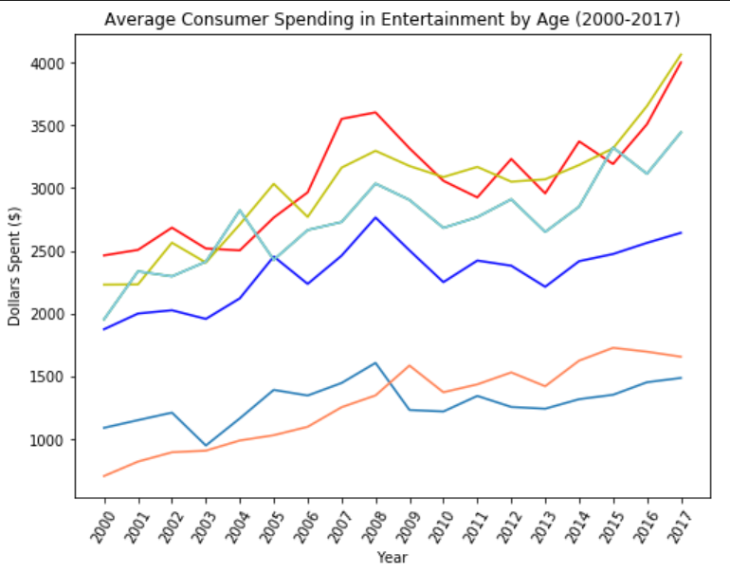
RESULTS: TRENDS BY AGE (Comparison)

Slide 9
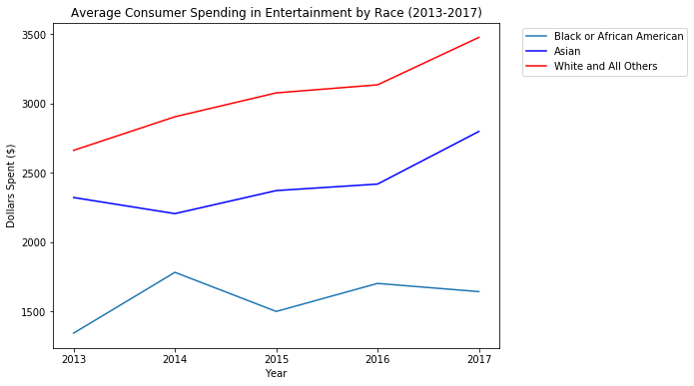
RESULTS: TRENDS BY RACE
What are the trends from 2013-2017 for the overall entertainment category in total consumer expenditure?

Slide 10
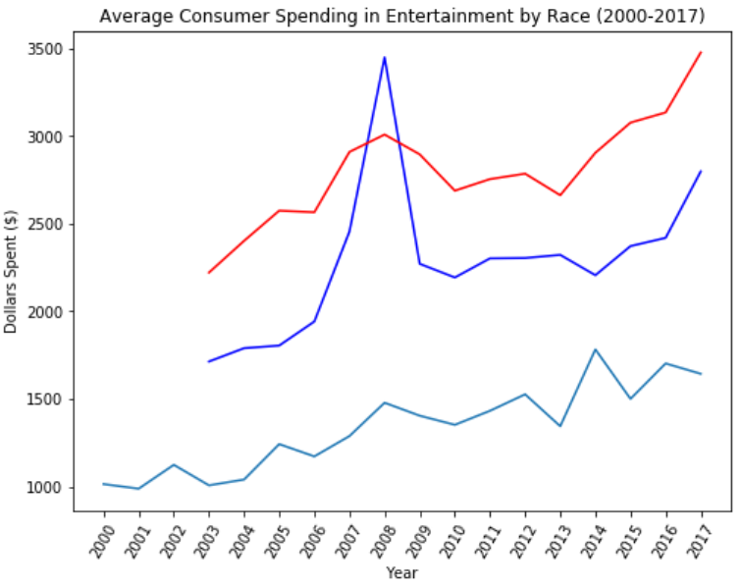
RESULTS: TRENDS BY RACE (Comparison)

Slide 11
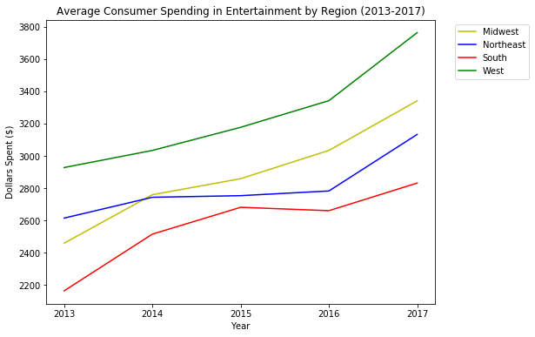
RESULTS: TRENDS BY REGION
What are the trends from 2013-2017 for the overall entertainment category in total consumer expenditure?

Slide 12
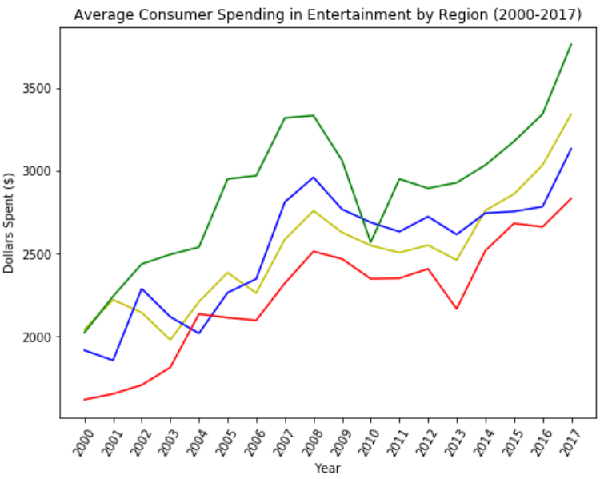
RESULTS: TRENDS BY REGION (Comparison)

Slide 13




FUN 2017 ENTERTAINMENT FACTS
What was the most played song on the radio in 2017?
What was the top grossing movie in 2017?
What was the most watched TV series in 2017?

Slide 14
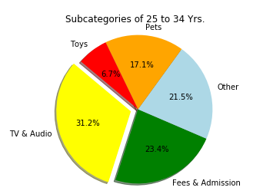
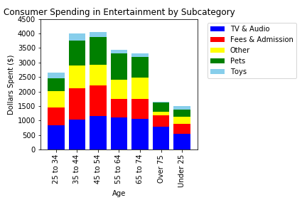
RESULTS: AGE
Which entertainment subcategories have the highest consumer expenditure by age?

Slide 15
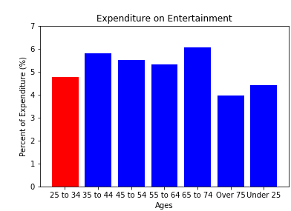
RESULTS: AGE
What is the % of average total expenditure spent on entertainment by age group?

Slide 16
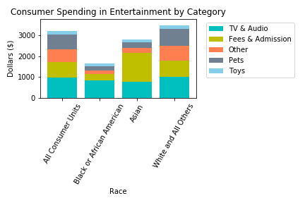
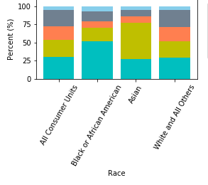
RESULTS: RACE
Which entertainment subcategories have the highest consumer expenditure by race?

Slide 17
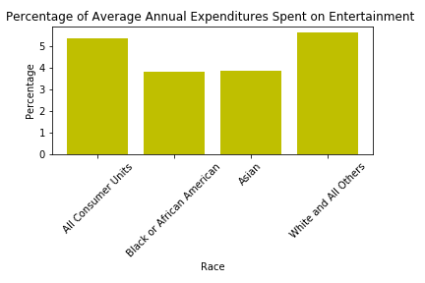
RESULTS: RACE
What is the % of average total expenditure spent on entertainment by race?

Slide 18
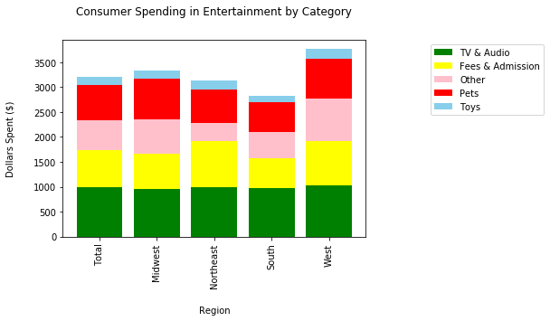
RESULTS: REGION
Which entertainment subcategories have the highest consumer expenditures by region?

Slide 19
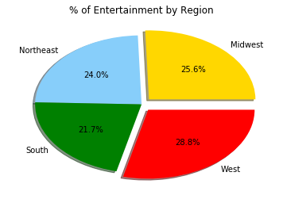
RESULTS: REGION
Which entertainment region has the highest consumer expenditure for entertainment?

Slide 20
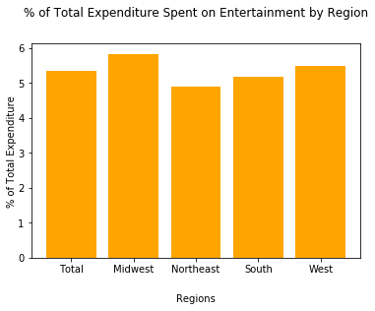
RESULTS: REGION
What is the % of average total expenditure spent on entertainment by region?

Slide 21
CONCLUSIONS
35 to 44 and 45 to 54 year olds both saw sharp increases in entertainment spending from 2016 to 2017
Black/African American and Asians saw increases in entertainment spending from 2016-2017 while White remained relatively flat.
All four geographical regions saw increases in entertainment spending from 2016-2017.
35 to 44 and 45 to 54 year olds have near identical spending habits.
65 to 74 year olds spend the most percent of their total expenditure on entertainment.
Asians spent the largest percent of their entertainment expenditures on fees and admissions.
White people spent the highest percentage of total expenditures on entertainment.
The West Region spent the most money on Entertainment.
The Midwest Region spent the largest amount of their total expenditures on on Entertainment.

Slide 22
AREAS FOR FURTHER STUDY
How does the US entertainment industry compares to the worldwide entertainment industry when looking at demographics?
Looking at consumer spending overall, not limit it to the entertainment category
Factors contributing to spending per category

